Slide 1
Application-Managed Flash
Sungjin Lee, Ming Liu, Sangwoo Jun, Shuotao Xu, Jihong Kim† and Arvind
Massachusetts Institute of Technology
†Seoul National University
14th USENIX Conference on File and Storage Technologies
February 22-25, 2016

Slide 2
NAND Flash and FTL
NAND flash SSDs have become the preferred storage devices in consumer electronics and datacenters
FTL plays an important role in flash management
The principal virtue of FTL is providing interoperability with the existing block I/O abstraction
Databases
File-systems
KV Store
…
Host System
Block I/O Layer
Flash Translation Layer (FTL)
Flash Device
Overwriting restriction
Asymmetric I/O operation
Limited P/E
cycles
Bad blocks
NAND Flash

Slide 3
FTL is a Complex Piece of Software
FTL runs complicated firmware algorithms to avoid in-place updates and manage unreliable NAND substrates
Databases
File-systems
KV Store
…
Host System
Block I/O Layer
Flash Translation Layer (FTL)
Flash Device
Address
Remapping
Garbage Collection
I/O
Scheduling
Wear-leveling &
Bad-block
…
NAND Flash
Requires significant hardware resources (e.g., 4 CPUs / 1-4 GB DRAM)
Incurs extra I/Os for flash management (e.g., GC)
Badly affects the behaviors of host applications

Slide 4
..But, Its Functionality is Mostly Useless
Many host applications manage underlying storage in a log-like manner, mostly avoiding in-place updates
Log-structured Host Applications
Object-to-storage
Remapping
Versioning & Cleaning
I/O Scheduling
…
Host System
Databases
File-systems
KV Store
…
Duplicate Management
Block I/O Layer
Flash Translation Layer (FTL)
Flash Translation Layer (FTL)
Address
Remapping
Garbage Collection
I/O
Scheduling
Wear-leveling &
Bad-block
Flash Device
Address
Remapping
Garbage Collection
I/O
Scheduling
Wear-leveling &
Bad-block
…
…
NAND Flash
This duplicate management not only (1) incurs serious performance penalties but also (2) wastes hardware resources

Slide 5
Which Applications???
File Systems
SpriteLFS
BlueSky
WAFL
F2FS
NILFS
Btrfs
HDFS
Key-value Stores
Databases
LevelDB
RethinkDB
Which Applications
???
RocksDB
Cassandra
BigTable
LSM-Tree
LogBase
MongoDB
Hyder
FlexVol
Storage Virtualization

Slide 6
Question:
What if we removed FTL from storage devices and allowed host applications to directly manage NAND flash?

Slide 7
Application-Managed Flash (AMF)
(2) The host runs almost all of the complicated algorithms
- Reuse existing algorithms to manage storage devices
Host Applications (Log-structured)
Log-structured Host Applications
Object-to-storage
Remapping
Versioning & Cleaning
I/O Scheduling
Object-to-storage
Remapping
Versioning & Cleaning
I/O Scheduling
…
…
…
Host System
…
AMF Block I/O Layer (AMF I/O)
Block I/O Layer
Flash Translation Layer (FTL)
Light-weight Flash Translation Layer
Flash Device
NAND Flash
Address
Remapping
Garbage Collection
I/O
Scheduling
Wear-leveling &
Bad-block
…
(1) The device runs essential device management algorithms
- Manages unreliable NAND flash and hides internal storage architectures
NAND Flash
(3) A new AMF block I/O abstraction enables us to separate the roles of the host and the device

Slide 8
AMF Block I/O Abstraction (AMF I/O)
AMF I/O is similar to a conventional block I/O interface
A linear array of fixed-size sectors (e.g., 4 KB) with existing I/O primitives (e.g., READ and WRITE)
Minimize changes in existing host applications
READ and WRITE
A logical layout exposed to applications
Sector (4KB)
Host Applications
Host System
AMF Block I/O Layer
Flash Device
…

Slide 9
Append-only Segment
Segment: a group of 4 KB sectors (e.g., several MB)
A unit of free-space allocation and free-space reclamation
Append-only: overwrite of data is prohibited
Host Applications
Appending new data (WRITE)
Overwrite
TRIM
Appending
Segment (MB)
Host System
AMF Block I/O Layer
Flash Device
…
Only sequential writes with no in-place updates
→ Minimize the functionality of the FTL

Slide 10
Case Study with AMF
File Systems
SpriteLFS
BlueSky
WAFL
F2FS
NILFS
Btrfs
HDFS
Key-value Stores
Databases
LevelDB
RethinkDB
Which Applications
???
RocksDB
Cassandra
BigTable
LSM-Tree
LogBase
MongoDB
Hyder
FlexVol
Storage Virtualization

Slide 11
Case Study with File System
Host Applications (Log-structured)
AMF Log-structured File System (ALFS)
(based on F2FS)
Object-to-storage
Remapping
Versioning & Cleaning
I/O Scheduling
…
…
Host System
AMF Block I/O Layer
Flash Device
AMF Flash Translation Layer (AFTL)
Segment-level Address
Remapping
Wear-leveling &
Bad-block
NAND Flash

Slide 12
AMF Log-structured File System (ALFS)
ALFS is based on the F2FS file system
How did we modify F2FS for ALFS?
Eliminate in-place updates
F2FS overwrites check-points and inode-map blocks
Change the TRIM policy
TRIM is issued to individual sectors
How many new codes were added?
1300 lines
<A comparison of source-code lines of F2FS and ALFS>

Slide 13
How Conventional LFS (F2FS) Works
Check-Point
Segment
Inode-Map
Segment
Data
Segment 0
Data
Segment 1
Data
Segment 2
Segment
LFS
PFTL
Block with 2 pages
* PFTL: page-level FTL

Slide 14
How Conventional LFS (F2FS) Works
Check-point and inode-map blocks are overwritten
Check-Point
Segment
Inode-Map
Segment
Data
Segment 0
Data
Segment 1
Data
Segment 2
CP
CP
B
E
B
F
G
CP
IM
#0
A
B
C
D
CP
IM
#0
LFS
Invalid
PFTL
* PFTL: page-level FTL

Slide 15
How Conventional LFS (F2FS) Works
Check-Point
Segment
Inode-Map
Segment
Data
Segment 0
Data
Segment 1
Data
Segment 2
CP
CP
IM
#0
A
B
E
B
F
G
CP
IM
#0
B
C
D
LFS
PFTL
CP
A
B
C
D
IM
#0
CP
E
B
F
G
IM
#0
CP
The FTL appends incoming data to NAND flash
* PFTL: page-level FTL

Slide 16
How Conventional LFS (F2FS) Works
Check-Point
Segment
Inode-Map
Segment
Data
Segment 0
Data
Segment 1
Data
Segment 2
CP
CP
IM
#0
A
B
E
B
F
G
CP
IM
#0
B
C
D
LFS
PFTL
CP
A
C
D
E
A
B
C
C
D
D
IM
#0
CP
E
E
B
F
G
IM
#0
CP
A
The FTL triggers garbage collection
: 4 page copies and 4 block erasures
* PFTL: page-level FTL

Slide 17
How Conventional LFS (F2FS) Works
Check-Point
Segment
Inode-Map
Segment
Data
Segment 0
Data
Segment 1
Data
Segment 2
CP
CP
IM
#0
A
B
C
D
E
B
F
G
C
D
CP
IM
#0
A
B
C
D
A
LFS
PFTL
TRIM
A
C
D
CP
A
D
E
A
C
D
A
B
C
C
D
D
IM
#0
CP
E
E
B
F
G
IM
#0
CP
A
C
The LFS triggers garbage collection
: 3 page copies
* PFTL: page-level FTL

Slide 18
How ALFS Works
Check-Point
Segment
Inode-Map
Segment
Data
Segment 0
Data
Segment 1
Data
Segment 2
Segment
ALFS
AFTL
Segment with 2 flash blocks

Slide 19
How ALFS Works
No in-place updates
Check-Point
Segment
Inode-Map
Segment
Data
Segment 0
Data
Segment 1
Data
Segment 2
CP
CP
CP
E
B
F
G
CP
CP
IM
#0
A
B
IM
#0
IM
#0
B
C
D
ALFS
AFTL
CP
CP
CP
IM
#0
IM
#0
A
B
C
D
E
B
F
G
No obsolete pages – GC is not necessary

Slide 20
How ALFS Works
Check-Point
Segment
Inode-Map
Segment
Data
Segment 0
Data
Segment 1
Data
Segment 2
CP
CP
CP
B
C
D
E
B
F
G
CP
CP
IM
#0
A
C
D
IM
#0
IM
#0
A
B
C
D
A
ALFS
AFTL
TRIM
CP
CP
CP
IM
#0
IM
#0
A
B
C
D
E
B
F
G
A
C
D
A
B
C
D
The ALFS triggers garbage collection
: 3 page copies and 2 block erasures

Slide 21
Comparison of F2FS and AMF
Duplicate Management
F2FS |  | AMF
File System | PFTL | File System
3 page copies | 4 copies + 4 erasures | 3 copies + 2 erasures
7 copies + 4 erasures |  | 3 copies + 2 erasures

Slide 22
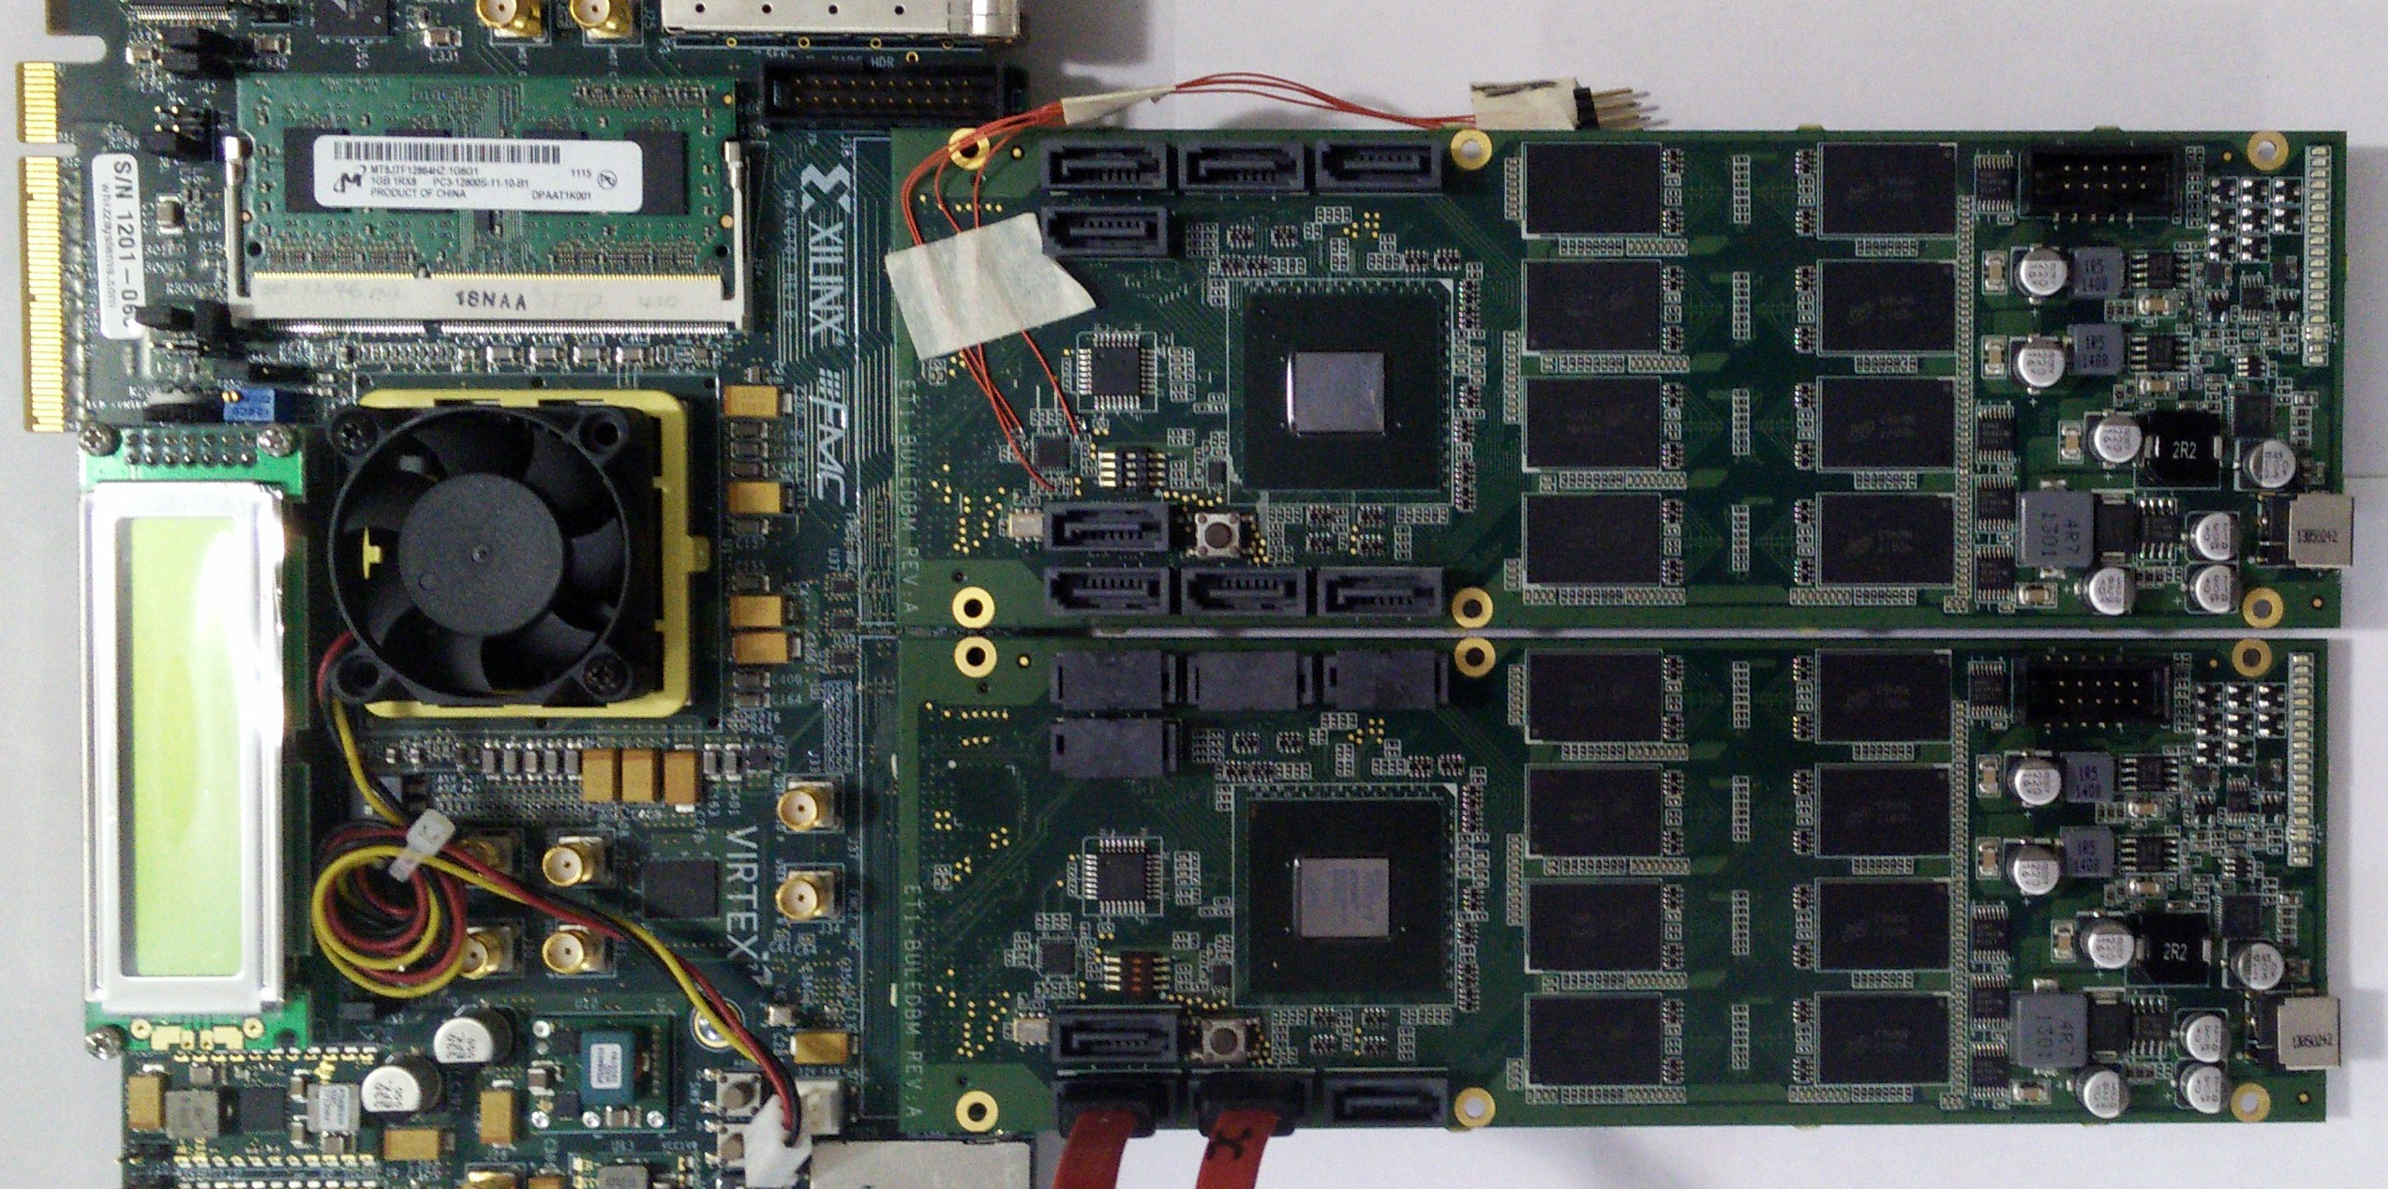
Experimental Setup
Implemented ALFS and AFTL in the Linux kernel 3.13
Compared AMF with different file-systems
Two file-systems: EXT4 and F2FS with page-level FTL (PFTL)
Ran all of them in our in-house SSD platform
BlueDBM developed by MIT

Slide 23
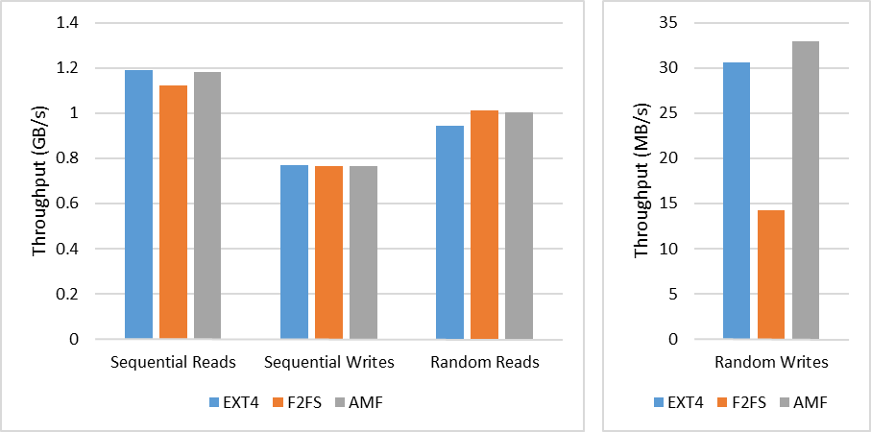
Performance with FIO
For random writes, AMF shows better throughput
F2FS is badly affected by the duplicate management problem

Slide 24
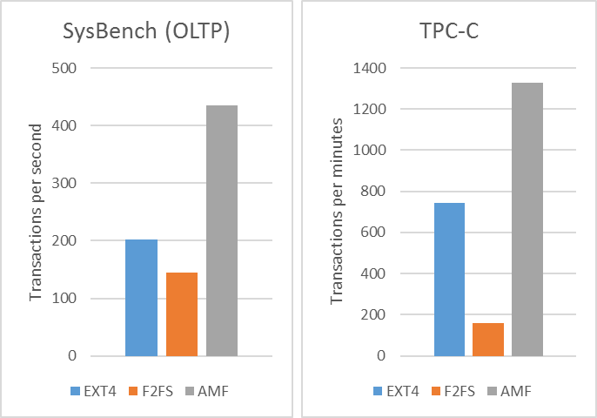
Performance with Databases
AMF outperforms EXT4 with more advanced GC policies
F2FS shows the worst performance

Slide 25
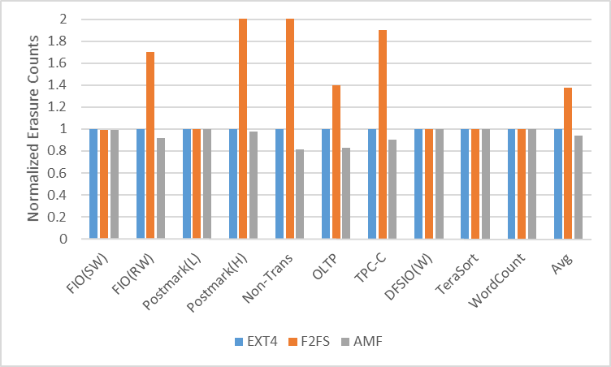
Erasure Counts
AMF achieves 6% and 37% better lifetimes than EXT4 and F2FS, respectively, on average

Slide 26
Resource (DRAM & CPU)
FTL mapping table size
Host CPU usage
SSD Capacity | Block-level FTL | Hybrid FTL | Page-level FTL | AMF
512 GB | 4 MB | 96 MB | 512 MB | 4 MB
1 TB | 8 MB | 186 MB | 1 GB | 8 MB

Slide 27
Conclusion
We proposed the Application-Managed Flash (AMF) architecture.
AMF was based on a new block I/O interface, called AMF IO, which exposed flash storage as append-only segments
Based on AMF IO, we implemented a new FTL scheme (AFTL) and a new file system (ALFS) in the Linux kernel and evaluated them using our in-house SSD prototype
Our results showed that DRAM in the flash controller was reduced by 128X and performance was improved by 80%
Future Work
We are doing case studies with key-value stores, database systems, and storage virtualization platforms

Slide 28
Source Code
All of the software/hardware is being developed under the GPL license
Please refer to our Git repositories
Hardware Platform: https://github.com/sangwoojun/bluedbm.git
FTL: https://github.com/chamdoo/bdbm_drv.git
File-System: https://bitbucket.org/chamdoo/risa-f2fs
Thank you!

